Slide 1
CapSTONE Final Project
Best Office location for financial firm in Toronto

Slide 2
Best location is KEY to Business growth
A financial firm is looking for a location to set up office in Toronto where it can start business and grow
The firm is in business of personal loans, home loans and similar type of loans.
Firm is looking for location where it can find maximum number of people requiring loans.

Slide 3
Problem Statement
The firm needs to find an office, which is convenient to majority of the people who are looking for loans. Such type of loans are usually needed by following type
Office employees – looking for personal loan, home loan
People working in restaurants and cafe – looking for personal loan, home loan
Students – looking for higher studies loan
Best location with highest footfall is key to success of financial firm in Toronto

Slide 4
Data Analysis
The data analysis is worked out in two phases
Phase 1: Find the locations having office, café, restaurants and schools in Toronto and identify them visually on a map. The foursquare API will be used to find the locations.
Phase 2: Create "clusters" of the above locations to identify potential places to choose. Financial firm can then decide to choose one or more than one of the suggested locations to start business in Toronto.

Slide 5
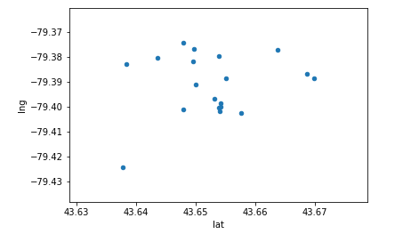
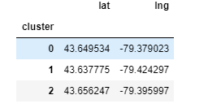
Data Analysis
Below is the data analysis on the cluster of locations with latitude and longitude mapping
Below is latitude and longitude in three cluster mapping

Slide 6
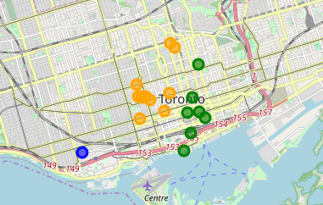
Data Analysis
Below is the data analysis on the cluster of locations on the map of Toronto shown in color coded in three clusters

Slide 7
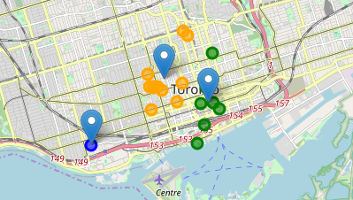
Result
The below map shows three clusters where we have schools, restaurants, cafe and offices are the best place for the financial firms to choose its office as most of the potential clients of the firm are located or come to these locations on regular basis.

Slide 8
Conclusion and Future Directions
Built Model to predict the best location for setup of office
Accuracy of model has room for improvement
Footfall based on the highest concentration of the potential customers in an area is used for generating the potential locations for Financial firm office

